Slide 1
Investment Research Assistant Fine-Tuned GPT Model + Streamlit Application
Maxim Bilenkin
DSC 670 Advanced Uses of Generative AI
Milestone 4
Winter 2025-2026

Slide 2
Project Overview
Developed a fine-tuned GPT-3.5 model
Focused on SEC 10-K style financial analysis
Designed to generate analyst-style summaries and risk assessments
Built an interactive web application using Streamlit

Slide 3
Model Fine-Tuning
Base Model: gpt-3.5-turbo
Custom training data for investment research prompts
Structured responses for summaries and risk analysis
Goal: Improve consistency and financial reasoning quality

Slide 4
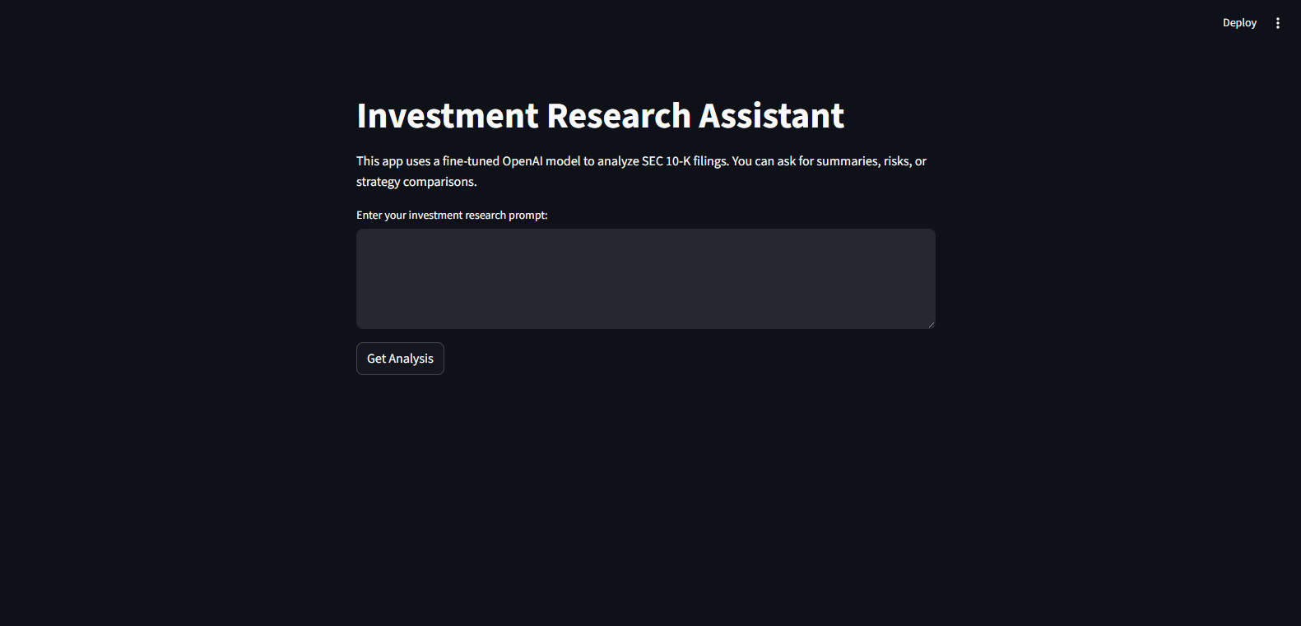
Streamlit Application
Built an interactive interface using Streamlit
User enters investment-related prompts
Application sends a request to the fine-tuned model
Displays analyst-style response in real-time

Slide 5
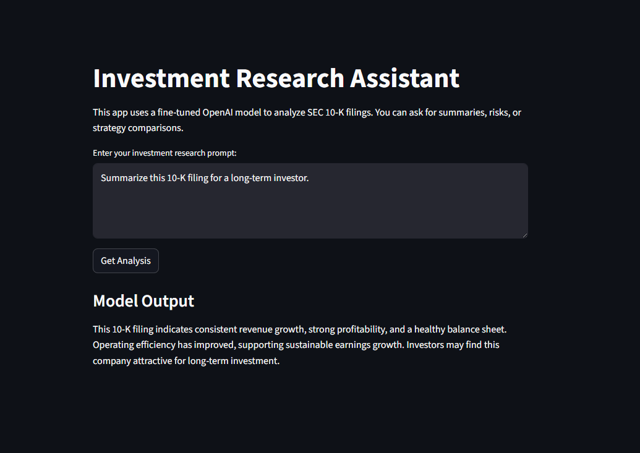
Example: Long-Term Investor Summary
Prompt:
Summarize this 10-K filing for a long-term investor.
Model Output:
This 10-K filing indicates consistent revenue growth, strong profitability, and a healthy balance sheet. Operating efficiency has improved, supporting sustainable earnings growth. Investors may find this company attractive for long-term investment.

Slide 6
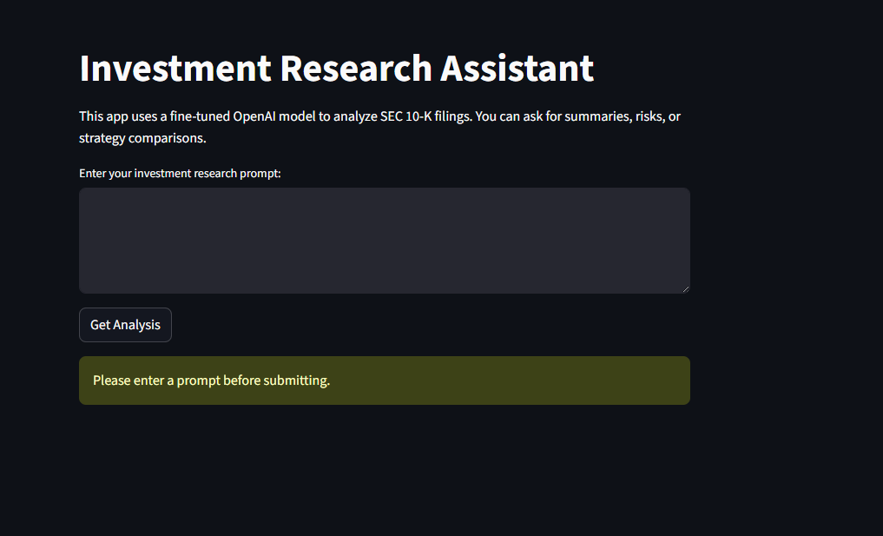
Edge Case Testing
Tested empty input submission
Application correctly prevents blank prompts
Displays a warning message:
"Please enter a prompt before submitting."

Slide 7
Key Takeaways
Successfully fine-tuned a GPT model for financial analysis
Built a functional Streamlit web application
Model produces structured investment insights
Application handles user input validation
Ready for future expansion using real SEC filings

